Slide 1
RC Car
ENEL 400 System Design Presentation
Matthew Selin, Ali Baloch, Mohammed Benhammou

Slide 2
Problem Definition:
Create alternative controls and assisted driving systems that allows users, who are unable to use conventional controls, to fully operate a vehicle.
Clarify objectives:
Develop motion controls for operating the vehicle.
Develop voice controls to increase user control over the vehicle.
Implement ultrasonic sensors to detect objects that are in the vehicle’s path to avoid collisions.
Develop a speed regulation system to assist the driver.
Develop preset maneuvers that the vehicle can perform autonomously and allow the user to invoke them by command.

Slide 3
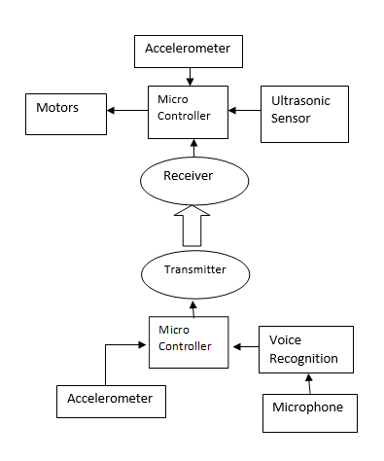
System Block Diagram

Slide 4
Motion Control
Requirements: The car will be controlled by a gesture user interface (accelerometer).
Constraints: User dexterity and ability to use motion controls will constrain the number of readable inputs. The tires on the vehicle cannot turn, they can only move forward/backwards.
Metrics: Tilting left /right or up/down controls the car to turn left/right or forward/backward.

Slide 5
Motion Control
Means: The user will have a controller with an accelerometer sensor. The controller will read input from the accelerometer and transmit the user’s gestures wirelessly to the microcontroller on the vehicle. The vehicle will use this input to control output to the individual motors. Portable batteries are required to provide power to both the vehicle and the user controller.

Slide 6


There will be 9 gestures that the user will be able to perform to control the vehicles motion. These gestures will be performed by tilting the controller forwards/backwards and left/right.

Slide 7
Voice Control
Requirements: Recognize specific voice commands and execute corresponding tasks. ex on/off..
Constraints: Voice commands must be easy to articulate. Avoid homonyms and slang words. Limited amount of voice commands will be recognized by the vehicle.
Means: The user controller will be equipped with a microphone and a voice recognition component. The controller will send commands to the vehicle if a voice command is recognized.

Slide 8
Speed Regulation System
Requirement: The vehicle should be able to sense how fast it is travelling and adjust output to the motors to maintain a constant speed.
Constraints: The vehicle will only have one or two speeds that are predefined.
Means:
The vehicle will be equipped with an accelerometer that can sense the vehicles speed. The microcontroller on the vehicle will read this input and adjust the output to the motors.

Slide 9
Speed Control Alternatives
Use tire rotation sensor to read input and control speed instead of an accelerometer.
Have the user regulate speed with voice controls.
Have the user regulate speed with motion controls.
Have user regulate speed with additional controls, such as buttons/switches/knobs.
Adding too much to the user controller may make operating the vehicle too complicated and takes away from the original client statement.

Slide 10
Client Statement:
Create alternative controls and assisted driving systems that allows users,
who are unable to use conventional controls, to fully operate a vehicle
Conventional Controls:
steering wheel
foot pedals
gear shifter
joystick, thumb stick
buttons?

Slide 11

Design Alternative: Eliminate the vehicles ability to drive backwards so that the gesture controller can be used for different controls such as controlling forward speed.

Slide 12
Wireless Communication
We are currently looking at components that can transmit and receive radio wave signals.
Signal must be able to be received up to 30 meters away.
Signal must not be obstructed by obstacles such as tables or walls.

Slide 13
Power Supply
We are planning to supply the user controller and the vehicle with power from 9v batteries.
The motors on the vehicle consume the most power.
We may have to develop some efficient use of power to avoid depleting the batteries rapidly.

Slide 14
Collision Avoidance System:
Requirements: The vehicle will detect obstacles that are in its path and stop to avoid collisions.
Metrics: Ultrasonic sensors will measure distance between itself and the closest object in its path. Once the vehicle becomes close to the obstacle it will stop to avoid collision.
Constraints: Ultrasonic sensors will not be able to detect small objects or objects that are far away. It will not detect objects that are not in its travel path. It won’t be able to detect holes or ledges.

Slide 15
Collision Avoidance System
Means: Ultrasonic sensor mounted on the front and back of the vehicle will allow the microcontroller to detect obstacles in its path. The vehicle will monitor these sensors and prohibit the vehicle from driving into stationary obstacles.

Slide 16
Self Driving
Requirements: The user will be able to command the vehicle to execute a predefined maneuver.
Metrics: The vehicle will have preset maneuvers such as pivoting and travelling a specific distance. The user will be able to invoke these maneuvers and the vehicle will drive itself according to the users command.
Constraints: Cannot program long maneuvers. Can only program a limited number of maneuvers.

Slide 17
Self Driving
Means: The vehicle will be programmed with specific maneuvers such as pivoting or travelling forwards/backwards a specific distance. The user will be able to invoke these maneuvers with their controller.

Slide 18
System Block Diagram

